Slide 1
Evaluating a model in Modeller
If several models are calculated for the same target, the ``best'' model can be selected by picking the model with the lowest value of the MODELLER objective function, which is reported in the second line of the model PDB file. The value of the objective function in MODELLER is not an absolute measure in the sense that it can only be used to rank models calculated from the same alignment.
(link: https://salilab.org/modeller/methenz/andras/node15.html​)

Slide 2
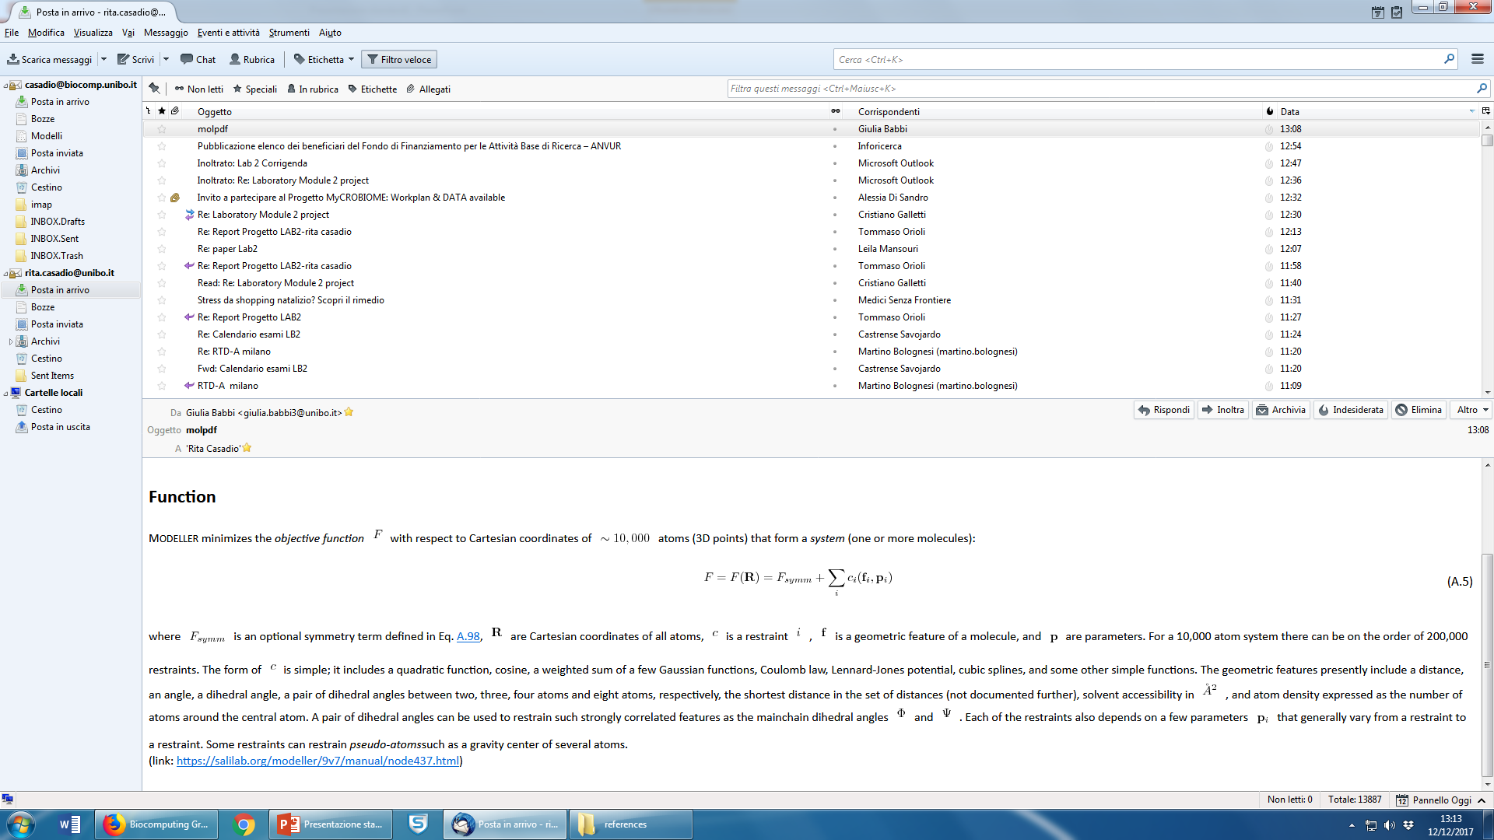

Slide 3
